Slide 1


Final Year Project
SpotCancerAI
Smart Skin Cancer Detection System
Supervised By: Mr Muhammad Usman Karim

Slide 2
Project Team
Muhammad Usman (24761)
Hassan Dastagir (40124)
Ali Sher Khan (39917)

Slide 3
Table of Content
Introduction and Background
Literature Review and Summary Table
Problem Statement
Methodology
Market Survey
Progress Report Summary
  Requirements
  Software System (Design + Implementation + Testing)
  Endeavour (Team)
Next Steps
Prototype / Report

Slide 4
INTRODUCTION AND BACKGROUND

Slide 5
Introduction and Background[1/2]
This project develops an AI-based model using deep learning to automatically detect and classify skin lesions from dermoscopic images. The AI-based model aims to accurately identify skin cancer types, such as melanoma, basal cell carcinoma and squamous cell carcinoma. The goal is to improve diagnostic accuracy and efficiency, supporting early skin cancer detection and assisting healthcare professionals in medical decision-making.

Slide 6
Introduction and Background[2/2]
Skin cancer is a major global health concern, with early detection being crucial for effective treatment. Traditional diagnostic methods such as visual examination by dermatologists, dermoscopy and skin biopsies, are often time-consuming, subjective, and require expert analysis. These limitations highlight the need for artificial intelligence (AI) to provide faster, more accurate, and automated skin cancer detection, improving early diagnosis and treatment outcomes.

Slide 7
Literature Review and Summary Table
References | Deep Learning techniques | Dataset | Accuracy
[1] | Applied MobileNet architecture | HAM10000 | 85%
[2] | Utilized VGG16 and Streamlit | Private collected dataset | 86%
[3] | k nearest neighbors model | Population-based Australian cohort study | 91%
[4] | federated learning system | ISIC2019 | 90%
[5] | Developed a deep learning system for differential diagnosis of 26 common skin conditions | Teledermatology | 66%
[6] | Implemented CNNs with Flask | ISIC | 90%
[7] | CNN models implemented with TensorFlow Lite | Seven classes on a combined dataset | 74.27%
[8] | EfficientNetB1 and EfficientNetB5 architectures | HAM10000 | 93%
We reviewed 15 research papers on Skin Cancer Detection, including 8 recent papers (2022–2024). These focused on deep learning techniques, diagnostic accuracy, and clinical applications, helping me understand current trends and challenges in the field.

Slide 8
Problem Statement
Skin cancer is one of the most common and deadly cancers worldwide. Early and accurate detection greatly improves survival rates. However, traditional diagnosis is slow, subjective, and depends on specialists. Limited access to dermatologists causes delays, especially in remote areas. Current AI tools lack accuracy and may not work well for diverse skin tones, highlighting the need for a reliable, accessible AI-based detection system.

Slide 9
Data Acquisition

Slide 10
Data Acquisition [1/5]
Dataset
We used HAM10000 dataset in our CNN-based pipeline of skin disease classification.
It has 10,015 dermatoscopic images of seven diseases, thus allowing not only effective preprocessing but also precise multi-class classification.

Slide 11
Data Acquisition [2/5]
Classes in HAM10000
The Seven Classes in dataset are:
Melanocytic nevi (6,705)
Melanoma (1,113)
Benign keratosis (1,099)
Basal cell carcinoma (514)
Bctinic keratoses (327)
Vascular lesions (142)
Dermatofibroma (115)

Slide 12
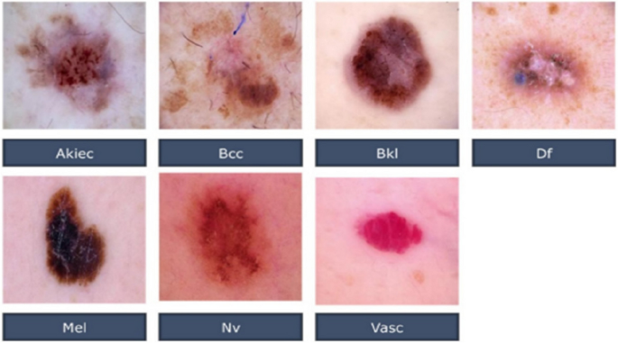
Data Acquisition [3/5]

Slide 13
Data Acquisition [4/5]
Dataset Splitting
Before Balancing
Split Type | Number of Images | Percentage
Train | 7,010 | 70.00%
Validation | 1,001 | 10.00%
Test | 2,004 | 20.00%
Total | 10,015 | 100.00%

Slide 14
Data Acquisition [5/5]
Dataset Splitting
After Balancing
Split Type | Number of Images | Percentage | Notes
Train | 32,851 | 91.60% | After augmentation & balancing
Validation | 1,001 | 2.79% | Original samples only
Test | 2,004 | 5.59% | Original samples only
Total | 35,856 | 100% | After balancing procedures

Slide 15
Methodology

Slide 16
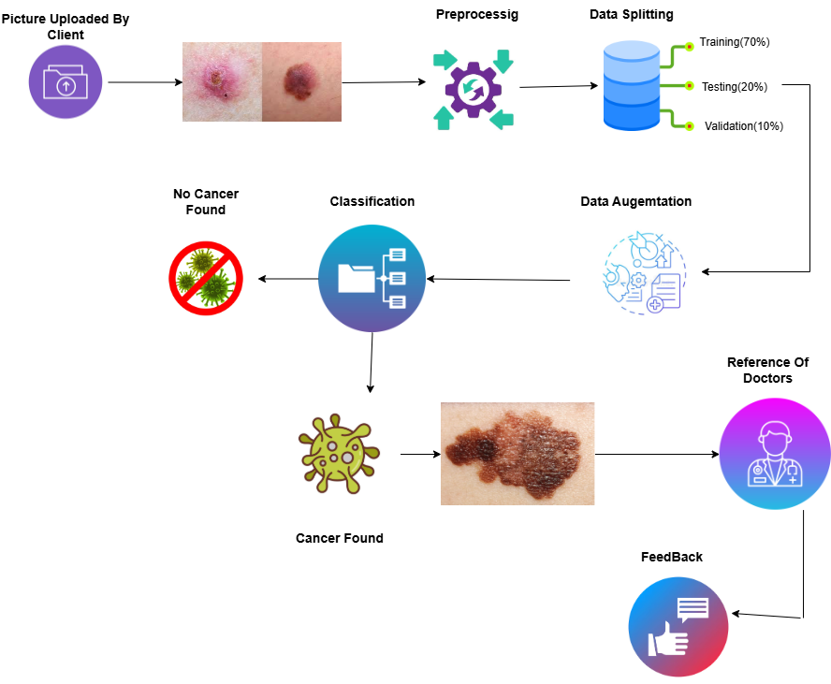
Methodology

Slide 17
Market Survey
Application | Technique | Test Set | Remarks
SkinVision App | Conditional generative adversarial neural network (segmentation) and SVM (classification) | ~black‑white melanoma photos → sensitivity 73%, specificity 83%, | CE‑marked; performance drops in real‑world lesions
SpotMole | Image processing techniques, ABCDE rule (Asymmetry Border Color Diameter Evolution) | 1 melanoma + 41 suspicious lesions (same Brisbane dataset): sensitivity 43%, specificity 80% | Low sensitivity (missed >50% melanomas); no recent updates, likely discontinued
Dr Mole | Algorithm based on the ABCDE rule (Asymmetry Border Color Diameter Evolution) | Same test set: 1 melanoma + 41 lesions → sensitivity 21%, specificity 100% | Only 1 malignant melanoma was Found
Lubax | Content-based image retrieval, k-nearest neighbor | 208 lesions with melanoma^{d} | Algorithm tested only on malignant melanoma (large lesions only)

Slide 18
PROGRESS REPORT
SUMMARY

Slide 19
Requirements
1.List Of Different Users:
  Patient
  Dermatologist
  Admin
2.Functional Requirements:
  Authentication & User Access Control
  Image Upload & Management
  AI-Powered Analysis
  Reporting & Documentation
  Consent, Privacy & Data Control
  Administrative & System Management

Slide 20
Requirements
3.Non_Functional Requirements:
Performance Requirements
Security Requirements
Usability Requirements
Scalability Requirements

Slide 21
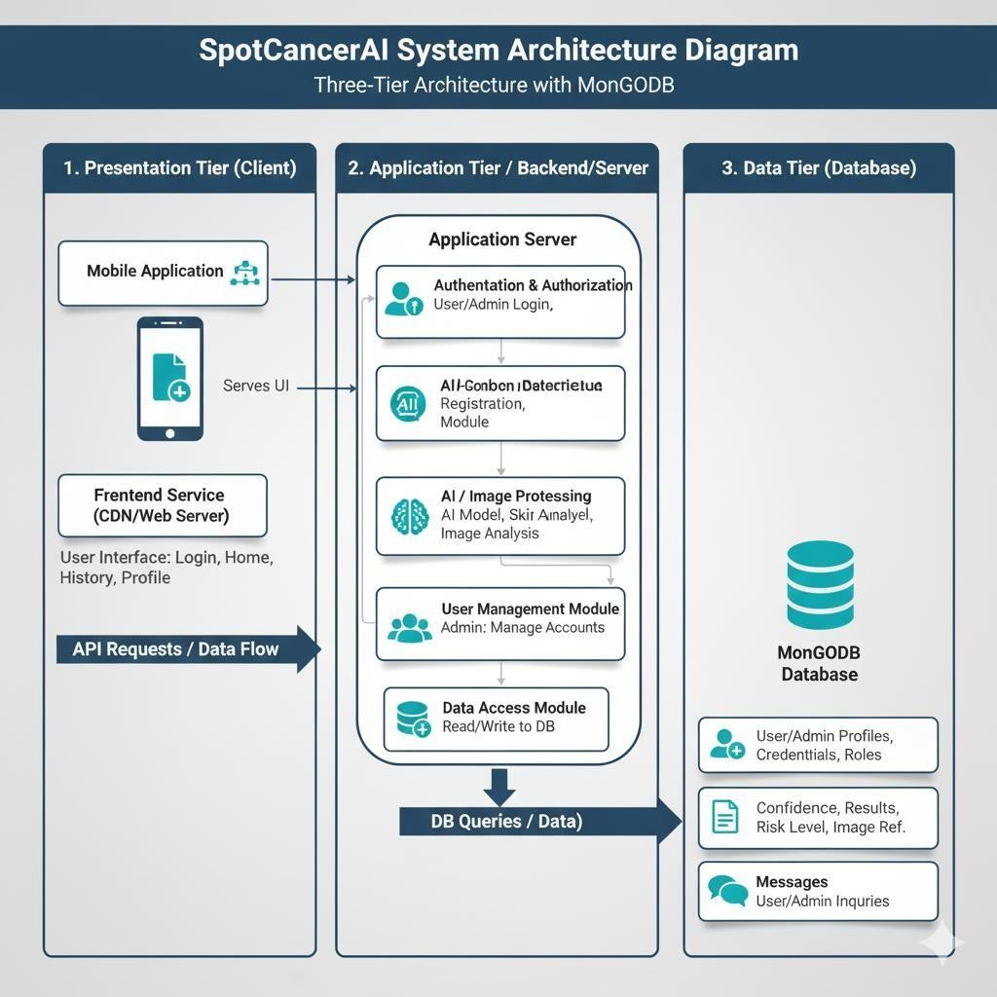
Design

Slide 22
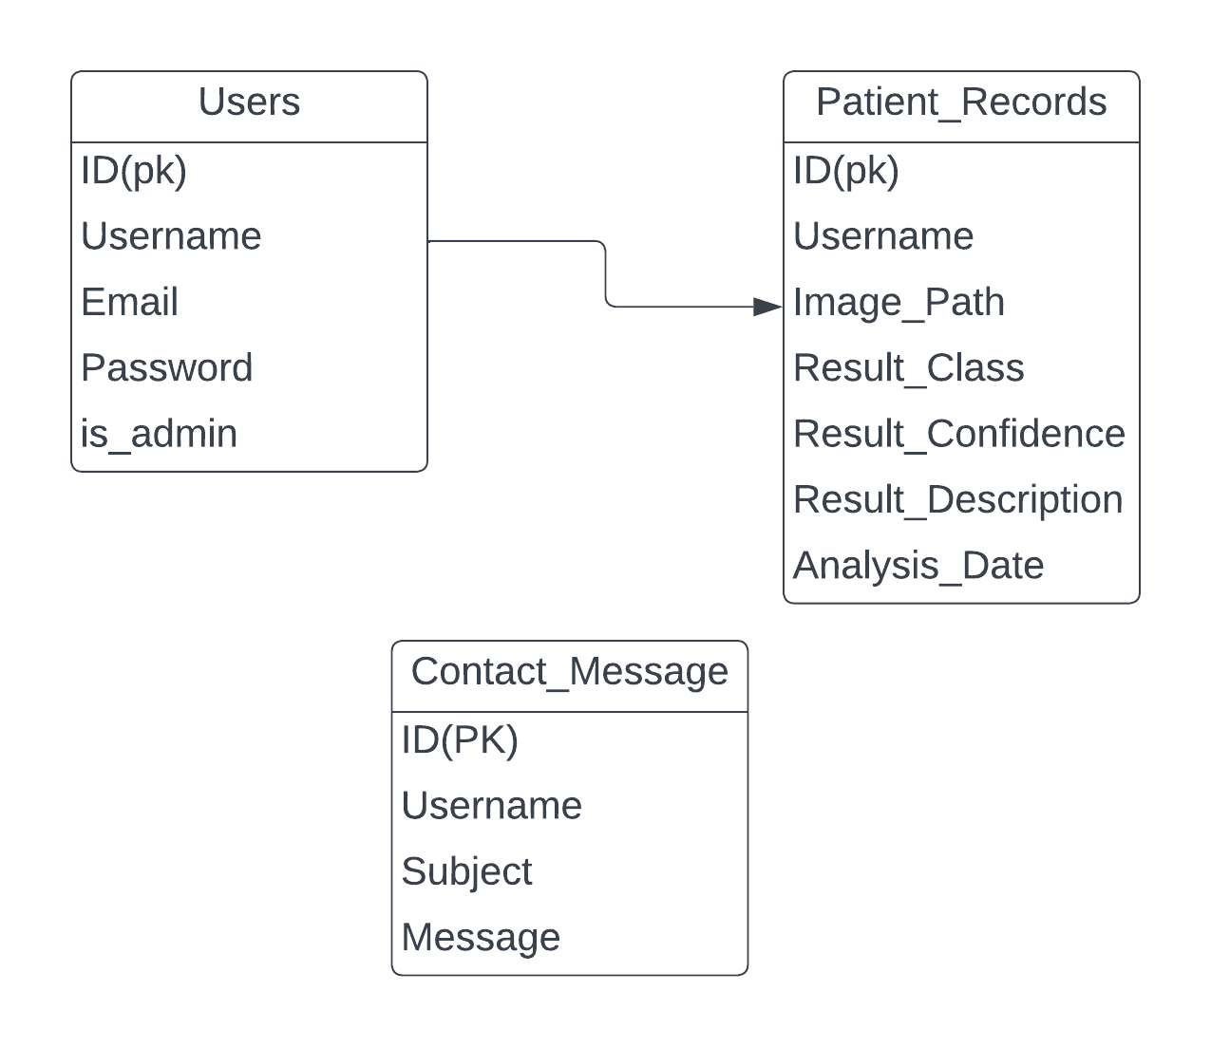
Design
ERD DIAGRAM:

Slide 23
Implementation[1/3]
List Development Tools & Technologies
Frontend: Flutter
Backend: Flutter
Database: SQL Lite
Programming Languages: Python
Machine Learning: TensorFlow, OpenCV ,Pandas
Version Control: GitHub (for collaboration version control and automation).

Slide 24
Implementation[2/3]
List Libraries / Components / Web Services
Frontend
Flutter
Backend
Flutter
SQL Lite
Python

Slide 25
Implementation[3/3]
Machine Learning Libraries:
TensorFlow
OpenCV
Pandas
Numpy
ImageDataGenerator

Slide 26
Testing[1/7]
Testing Results on Various Models
EfficientNetB5 Model Performance (OverSample)
Class | Precision | Recall | F1-Score | Support
akiec | 0.73 | 0.69 | 0.71 | 65
bcc | 0.90 | 0.76 | 0.82 | 103
bkl | 0.68 | 0.73 | 0.70 | 220
df | 0.83 | 0.68 | 0.75 | 22
mel | 0.55 | 0.64 | 0.59 | 223
nv | 0.93 | 0.91 | 0.92 | 1342
vasc | 0.89 | 0.83 | 0.86 | 29
Accuracy | - | - | 0.84 | 2004
Macro_Avg | 0.79 | 0.75 | 0.76 | 2004
Weighted_Avg | 0.85 | 0.84 | 0.84 | 2004

Slide 27
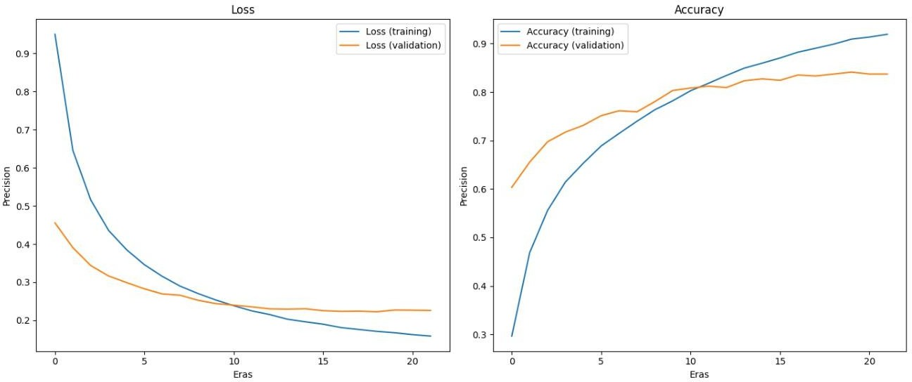
Testing[2/7]
EfficientNetB5 Model Performance

Slide 28
Testing[3/7]
InceptionV3 Model Performance
Class | Precision | Recall | F1-Score | Support
akiec | 0.39 | 0.37 | 0.38 | 65
bcc | 0.43 | 0.48 | 0.45 | 103
bkl | 0.35 | 0.62 | 0.45 | 220
df | 0.15 | 0.27 | 0.19 | 22
mel | 0.32 | 0.56 | 0.40 | 223
nv | 0.92 | 0.64 | 0.76 | 1342
vasc | 0.12 | 0.31 | 0.18 | 29
Accuracy |  |  | 0.60 | 2004
Macro Avg | 0.38 | 0.46 | 0.40 | 2004
Weighted Avg | 0.73 | 0.60 | 0.64 | 2004

Slide 29
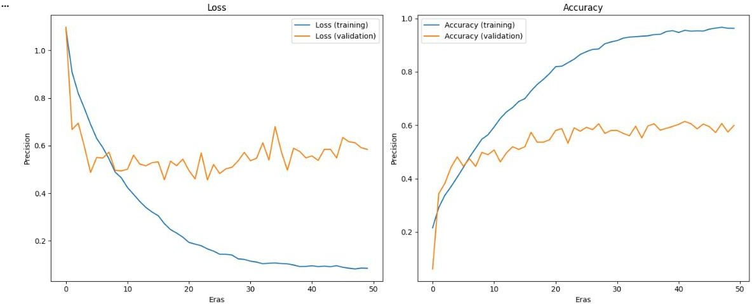
Testing[4/7]
InceptionV3 Model Performance

Slide 30
Testing[5/7]
ResNet Model Performance
Class | Precision | Recall | F1-Score | Support
akiec | 0.44 | 0.62 | 0.51 | 65
bcc | 0.55 | 0.60 | 0.57 | 103
bkl | 0.48 | 0.65 | 0.55 | 220
df | 0.29 | 0.55 | 0.37 | 22
mel | 0.40 | 0.65 | 0.50 | 223
nv | 0.96 | 0.76 | 0.84 | 1342
vasc | 0.73 | 0.76 | 0.75 | 29
Accuracy |  |  | 0.72 | 2004
Macro Avg | 0.55 | 0.65 | 0.59 | 2004
Weighted Avg | 0.79 | 0.72 | 0.74 | 2004

Slide 31
Testing[6/7]
EfficientNetB5 Model Performance (UnderSample)
Class | Precision | Recall | F1-Score | Support
akiec | 0.54 | 0.66 | 0.59 | 65
bcc | 0.66 | 0.81 | 0.73 | 103
bkl | 0.74 | 0.62 | 0.67 | 220
df | 0.55 | 0.73 | 0.63 | 22
mel | 0.44 | 0.78 | 0.56 | 223
nv | 0.97 | 0.83 | 0.89 | 1342
vasc | 0.70 | 0.90 | 0.79 | 29
Accuracy |  |  | 0.79 | 2004
Macro Avg | 0.66 | 0.76 | 0.69 | 2004
Weighted Avg | 0.84 | 0.79 | 0.81 | 2004

Slide 32
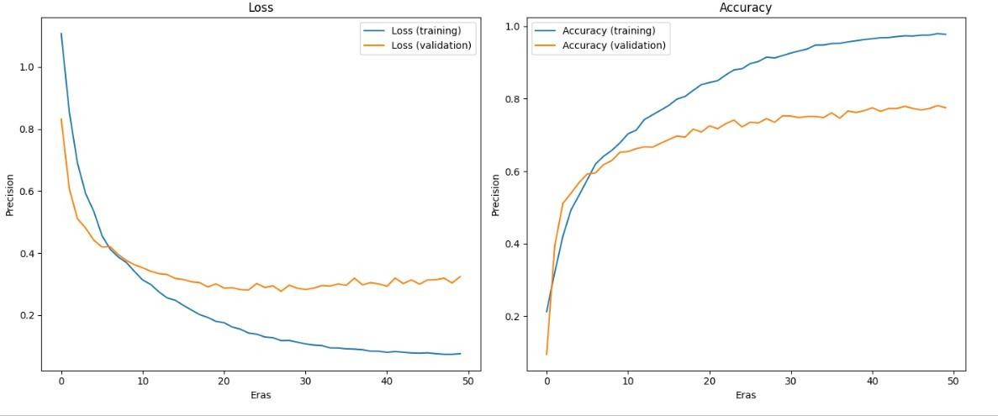
Testing[7/7]
EfficientNetB5 Model Performance (UnderSample)

Slide 33
ENDEAVOUR

Slide 34
Endeavour(1/2)
Hassan Dastagir:
Model Training
BackEnd
Documentation
Ali Sher Khan:
Model Training
Fine Tuning
Front End Designing & Development
Muhammad Usman:
Front End Designing & Development
Documentation

Slide 35
Endeavour(2/2)
software development process
Requirements Gathering & Analysis
Preprocessing & Data Management
Data Splitting & DataFrames
Augmentation
Model Design & Architecture
Training & Testing
Implementation & Integration (Flutter Web/App)

Slide 36
NEXT STEPS

Slide 37
Work Breakdown Structure
Project Planning & Setup
  Define Project goals and scope.
  Select Technologies and frameworks.
  Create Initial Project Timeline.
Data Collection & Preprocessing
  Collect Dataset From Kaggle (HAM10000).
  Preprocess images(resize,gaussian blur, inpaint etc)
  Split data into Train (70%),Testting(20%),Validation(10%). . .
  Perform Data Augemtation (Brightness range,shear_range ,Zoom_range etc).
Website Development
  Create Dashboard(login,signup ,Forgotpassword,).
  Design User Interface(Home,Analyze,contact,patient_records,Profile logout).
  Admin Interface(Admin Dashbaord)..
  Integration.

Slide 38
Work Breakdown Structure
Testing & Validation
  Unit Testing
  Validation Set Evaluation
  Bug Fixing
Final Optimization
  Model Fine-tuning
  Hyperparameter Tuning
  Data Balancing
Maintenance & Documentation
  Project Report
  Version Control
  Model Retraining Plan
Mobile Application
  Frontend Design
  Backend
  Model Integration
  Testing on Devices

Slide 39
Challenges
Resources
Class Imbalance
Model Overfitting
Model Integration
Train Model On Different CNN Architecture

Slide 40
PROTOTYPE & REPORT

Slide 41
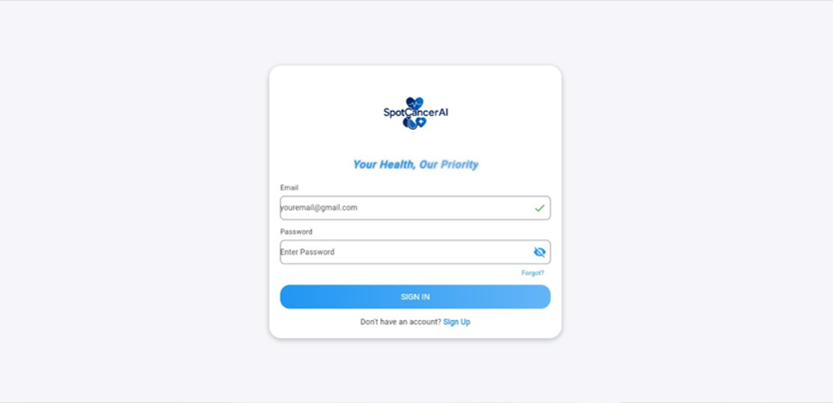
Prototype

Slide 42
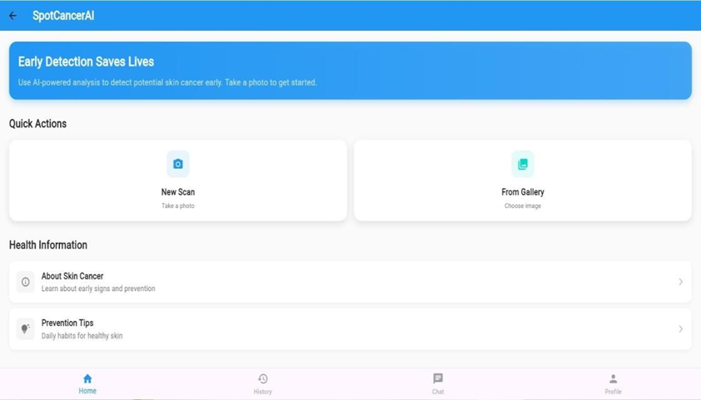
Prototype

Slide 43
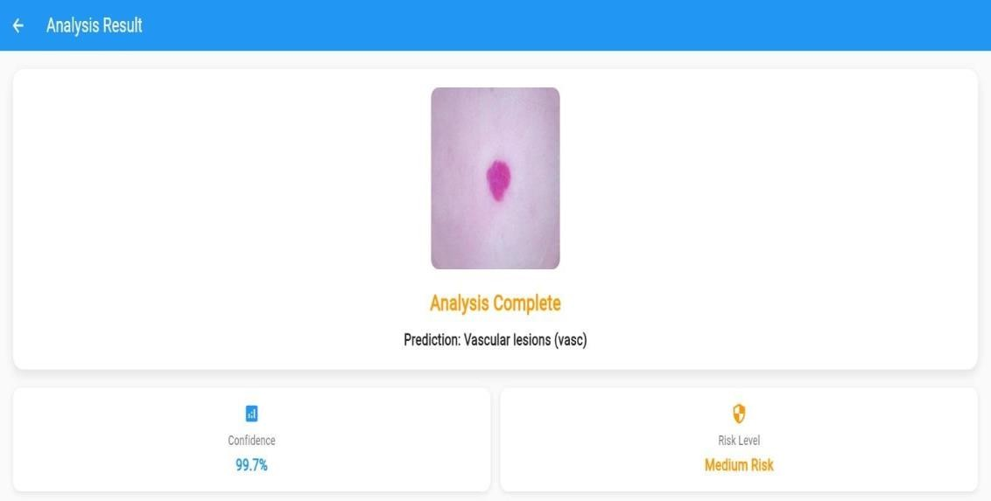
Prototype

Slide 44
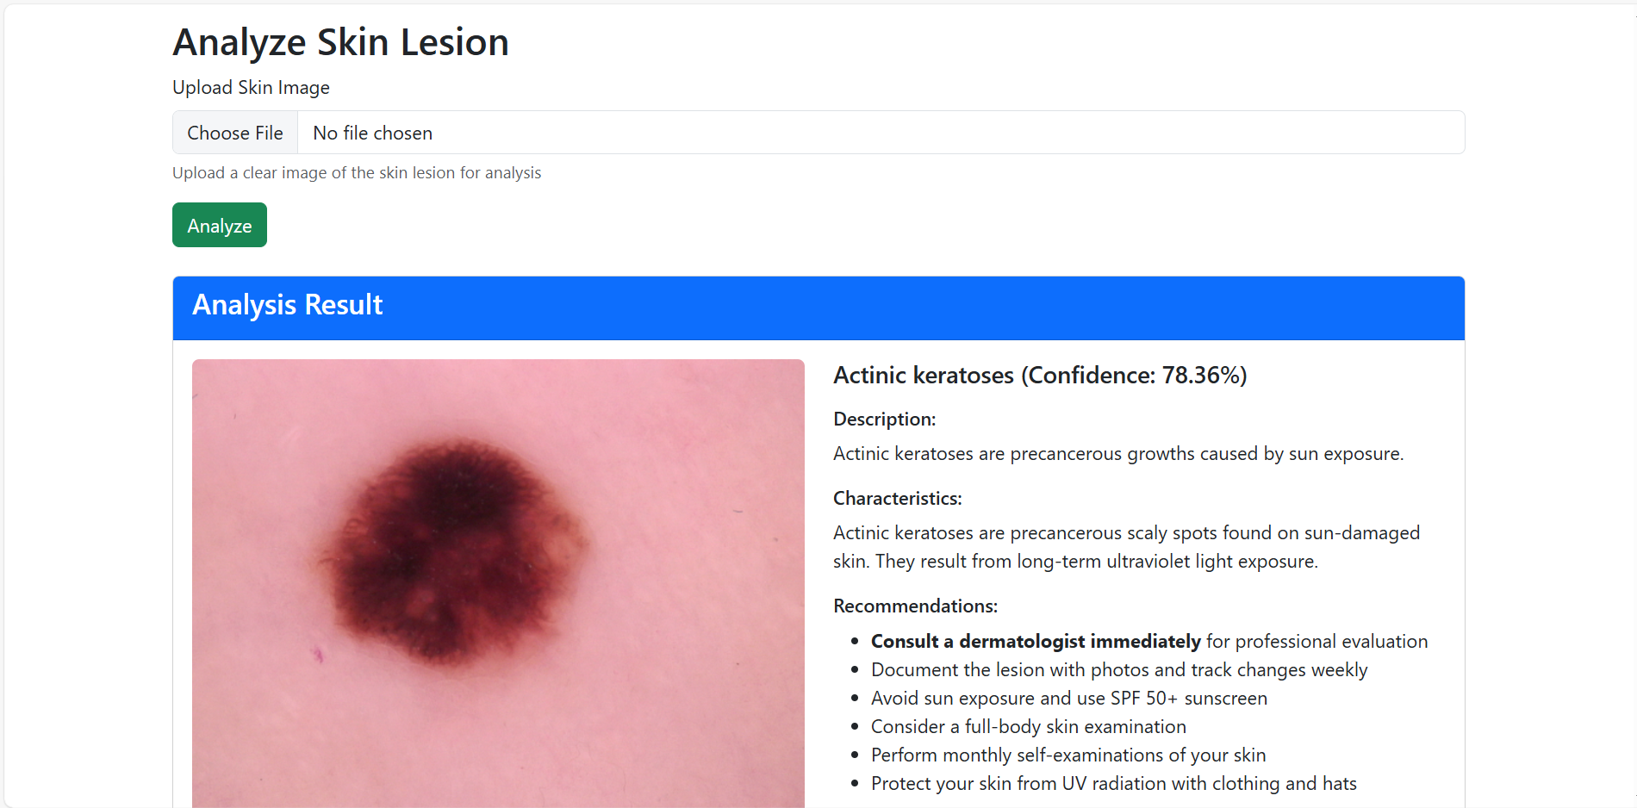
Prototype

Slide 45
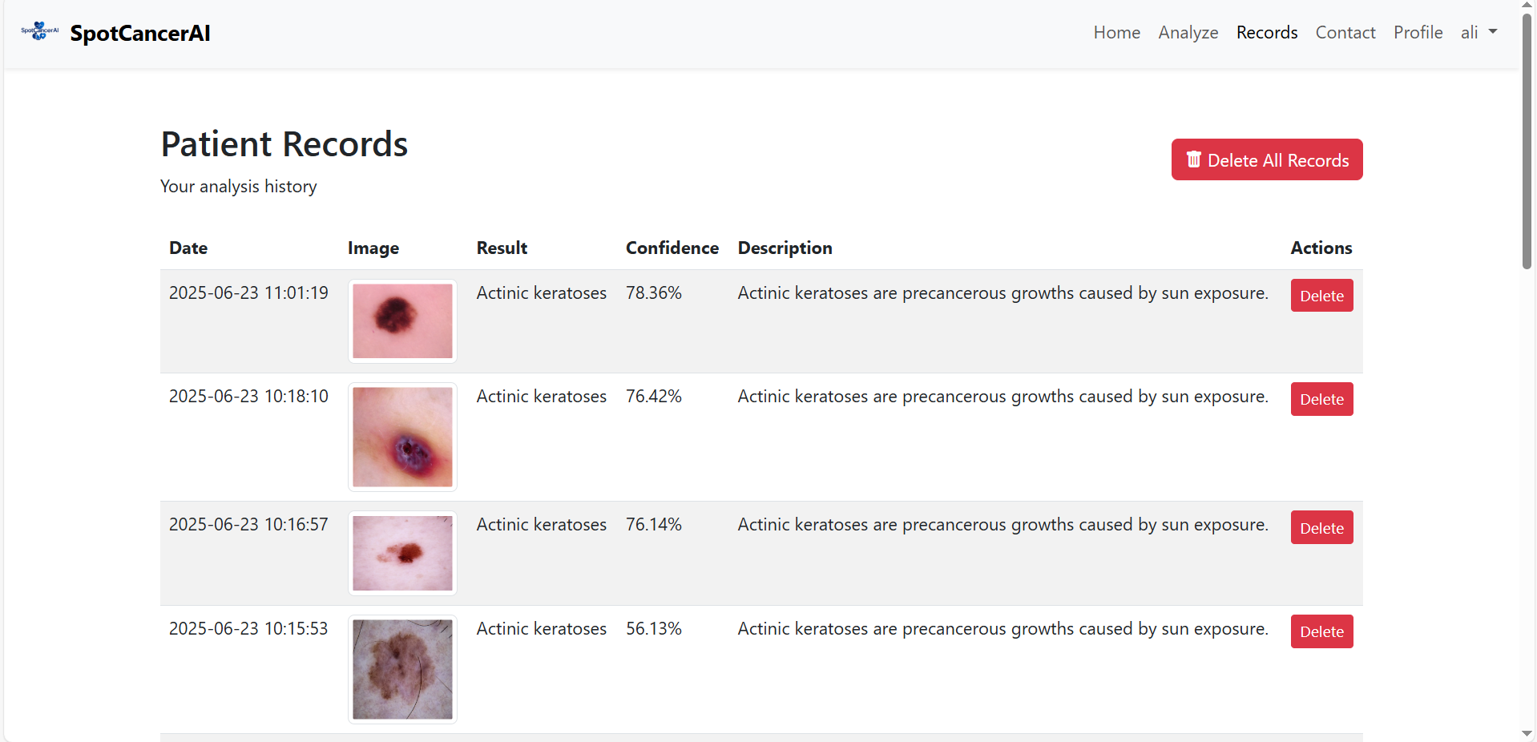
Prototype

Slide 46
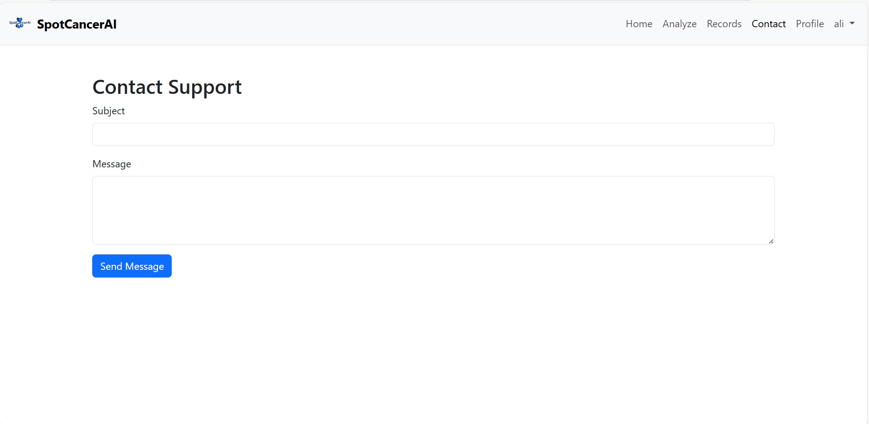
Prototype

Slide 47
Report
Chapter 1: Introduction
Chapter 2: Literature Review / Market Survey
Chapter 3: Requirements and Design
Chapter 4: Implementation and Test Cases
Chapter 5: Experiment Results and Analysis
Chapter 6: Conclusion & Future Direction

